Slide 1
Advanced Bootstrap – Forms & Components
Developing a Mobile Ready UI using CSS3

Slide 2
Atomic Global Classes
Bootstrap has a series of atomic global classes built in
These allows us to control common behaviour
Simplifying cross browser development
Working on DO NOT REPEAT (DRY) principles
For example the pull-left and pull-right classes
They can not be easily changed without using Less
We will use these later in the course
They can be overridden through CSS inheritance
.pull-left {
float: left !important;
}
.pull-right {
float: right !important;
}

Slide 3
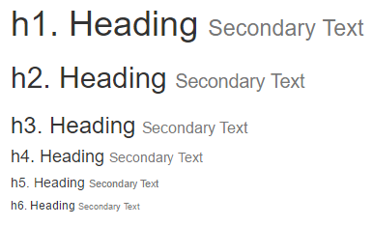
Typography
Bootstrap has numerous typography helper classes along with styling that is applied automatically across the site.
Headings have default styling and bootstrap echos this styling in its .h1-.h6 classes for if we wish to use another element but retain the style.
Utilise the <small> tag or .small class to create secondary text
Paragraphs are pre-set with a font size, line height and spacing

Slide 4
Lists
Bootstrap applies a small amount of styling automatically to lists
Some custom list classes also exist – including the inline-list
<ul class="list-inline">
<li><a href="#">Link 1</a></li>
<li><a href="#">Link 2</a></li>
<li><a href="#">Link 3</a></li>
<li><a href="#">Link 4</a></li>
</ul>

Slide 5
Lists
A “.dl-horizontal” class provides horizontal alignment for description lists
<dl class="dl-horizontal">
<dt>Decscription List</dt>
<dd>Perfect for providing descriptions of terms used on your page</dd>
<dt>Bootstrap</dt>
<dd>A CSS framework which provides the .dl-horizontal class to style our description lists with horizontal alignment</dd>
</dl>

Slide 6
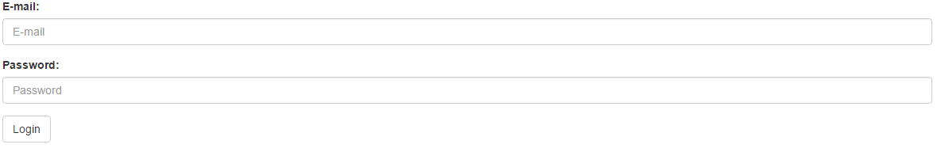
Bootstrap Forms
Bootstrap comes packaged with some default styling for forms
<form action="#">
<div class="form-group">
<label for="email“>E-mail:</label>
<input class="form-control" id="email" type="email" placeholder="E-mail">
</div>
<div class="form-group">
<label for="password">Password:</label>
<input type="password" class="form-control" id="password“ placeholder="Password">
</div>
<div class="form-group">
<button type="submit" class="btn btn-default">Login</button>
</div>
</form>
Notes:
The idea of a Grid is not dissimilar to drawing on a piece of graph paper. As a concept in design it became a common part of design and development in the Art Deco movement and give rise to the beloved Helvetica font.
Within web development they are CSS frameworks providing standardised rules for build and shortcuts for site construction using pre-prepared layout classes.
Grids save a lot of time in development, they implement many of the web’s best practices for desktop and mobile development. By learning to build a grid the basis of page construction is done for you leaving you to focus on the functionality and/or appearance of the page.
The CSS file that provides the grid provides a good reuse policy similar to the way jQuery has been used in page scripting.

Slide 7
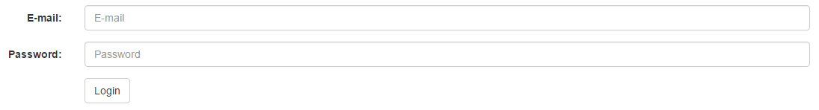
The Grid
Use the grid to create aligned, responsive forms
<form action="#" class="form-horizontal">
<div class="form-group">
<label for="email" class="col-sm-2 control-label">E-mail:</label>
<div class="col-sm-10"><input……></div>
</div>
<div class="form-group">
<label for="password" class="col-sm-2 control-label">Password:</label>
<div class="col-sm-10"><input……></div>
</div>
<div class="form-group">
<div class="col-sm-10 col-sm-offset-2"><button……></div>
</div>
</form>

Slide 8
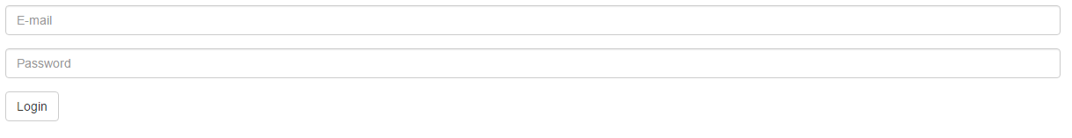
Accessibility
Use Bootstrap’s utility sr-only class to show only to screen readers
<form action="#" class="form-horizontal">
<div class="form-group">
<label for="email" class=“sr-only">E-mail:</label>
<input……>
</div>
<div class="form-group">
<label for="password" class=“sr-only">Password:</label>
<input……>
</div>
<div class="form-group">
<button……>
</div>
</div>
</form>

Slide 9
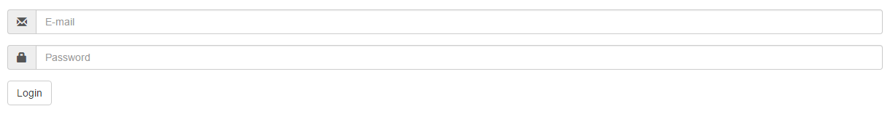
Add-ons
Use the input-group-addon class to create pre/post-fixed labels
<form>…
<div class="input-group">
<div class="input-group-addon">
<span class="glyphicon glyphicon-envelope"></span>
</div>
<input……>
</div>
</div>
<div class="form-group">
<label for="password" class="sr-only">Password:</label>
<div class="input-group">
<div class="input-group-addon">
<span class="glyphicon glyphicon-lock"></span>
</div>
<input……>
</div>
</div>
…</form>

Slide 10
Demonstration - CSS Components
Bootstrap also contains a series of CSS components
They provide solutions to common layout problems
These include
Alert boxes
Panels
Progress Bars
Thumbnails
List groups
Responsive embed

Slide 11
Review
Bootstrap simplifies much of the work we have done in the course
The Grid system is its basis
The CSS support gives us most of the tools we should need
Forms
Typography
Element alignment
Positioning
CSS Components

Slide 12
Exercise
Use Bootstrap to implement
A form
A responsive video player

